Slide 1
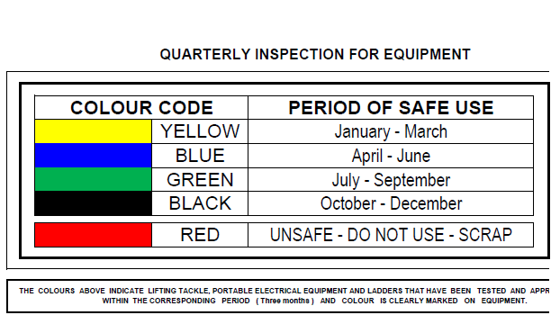
COLOR CODING OF EQUIPMENT

